Slide 1
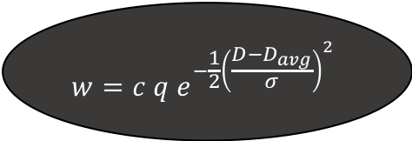
Data Analysis Flowchart
Prescription data
(~4.36 Gb)
Prescriber data
(~1.1 Mb)
Postal code coordinates
(~96.7 Mb)
Nationwide Crime data
(~2.6 Gb)
Get prescriber coordinates by postal codes in prescriber data
Group all crimes by location while ignoring crime type
Assign a location to each medication using prescriber data
Limit prescription data to most common prescriptions
Group medications by coordinates
Calculate distance between each crime and each prescriber (D)
$$w=c q e^{−\frac{1}{2}{\left(\frac{D−D_{avg}}{σ}\right)}^{2}}$$
Calculate weight for each crime location
w → weight
c → # of crimes at location
q → quantity of prescribed medication
D → distance from prescriber to crime
D_{avg} → mean of D
σ → standard deviation of D
Sum weights for each location
Generate correlation matrix
Map results with folium

Slide 2
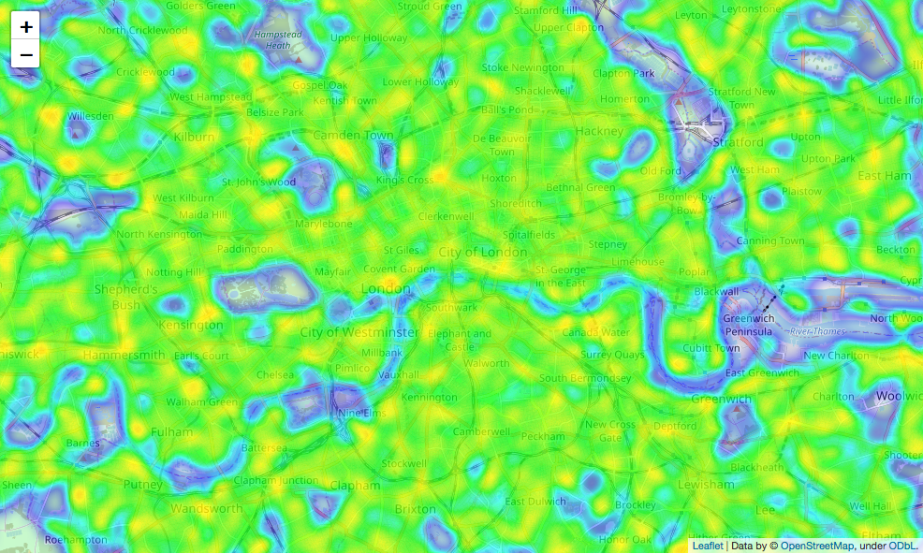


Heatmaps
Ibuprofen
Oxycontin
Prozac

